Slide 1
Progress towards large-scale analyses of mussel body temperatures
K. Allison Smith
University of South Carolina
2007 NASA Earth Systems Science Fellow

Slide 2
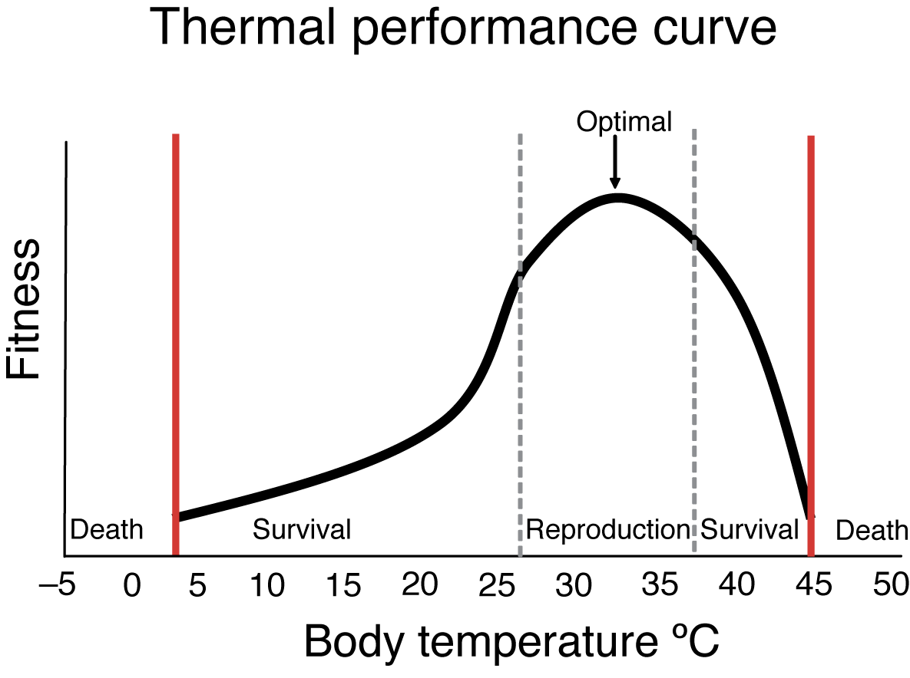
Kearney and Porter 2009

Slide 3
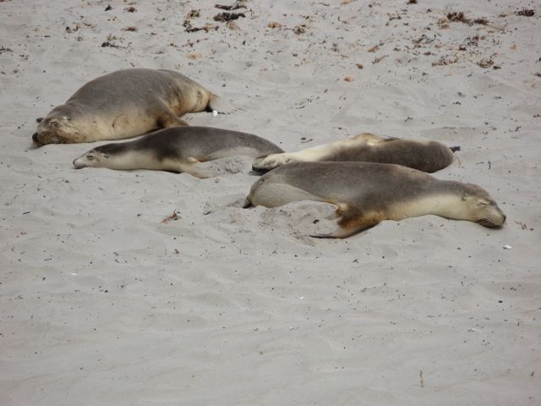
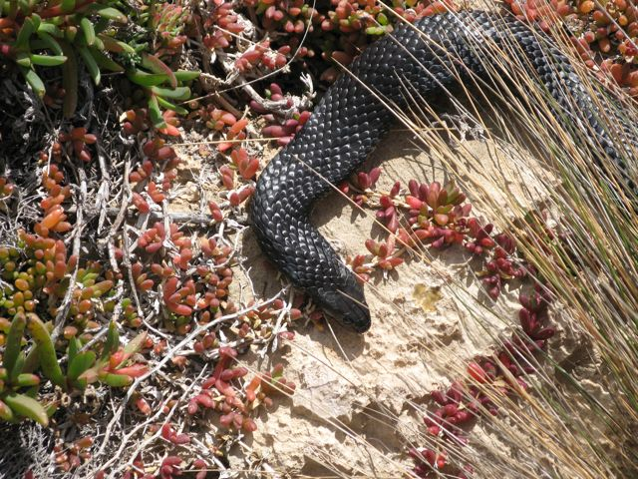
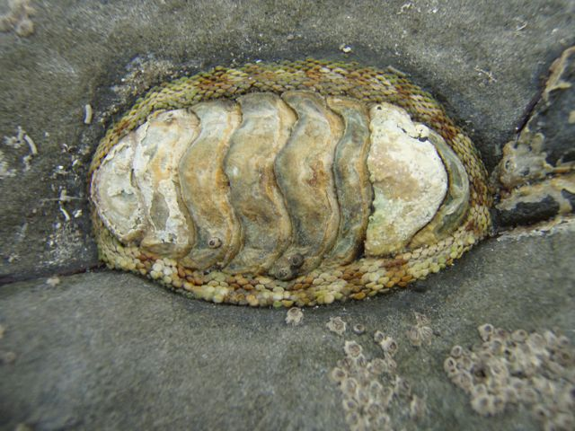
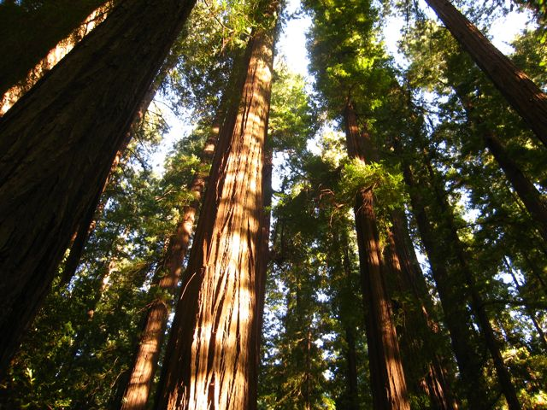
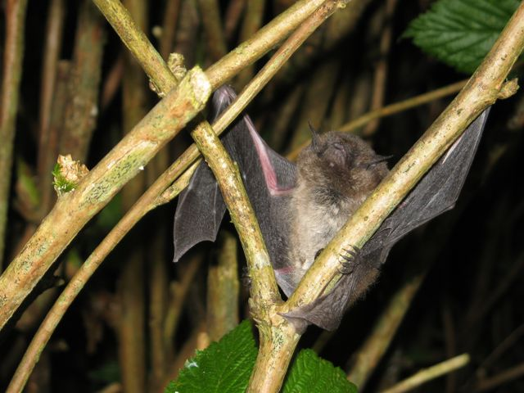
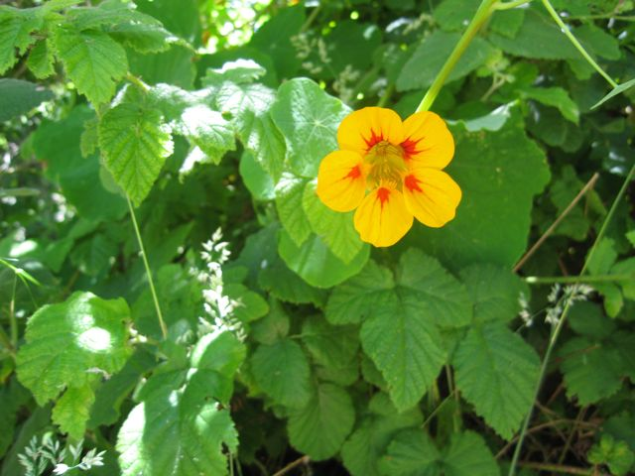
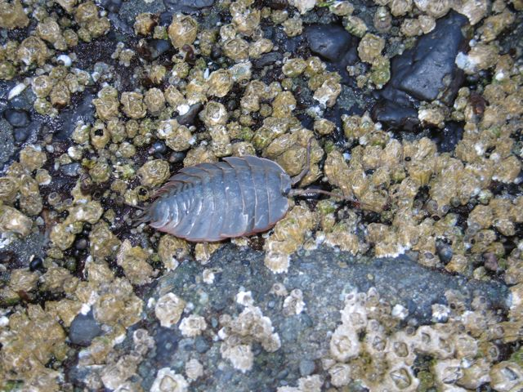
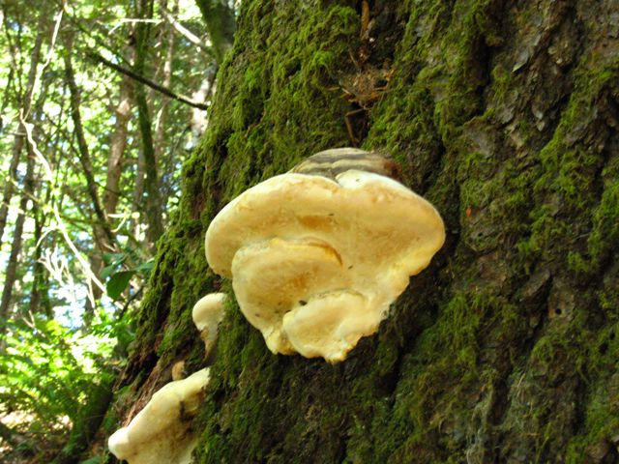
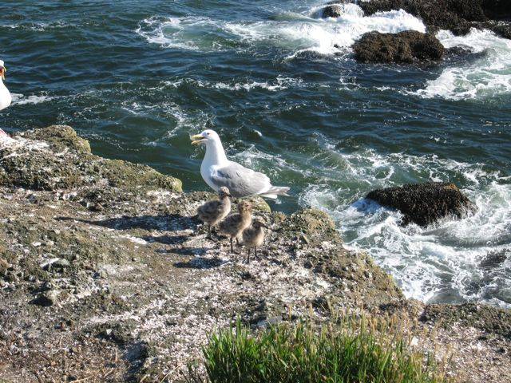

Slide 4
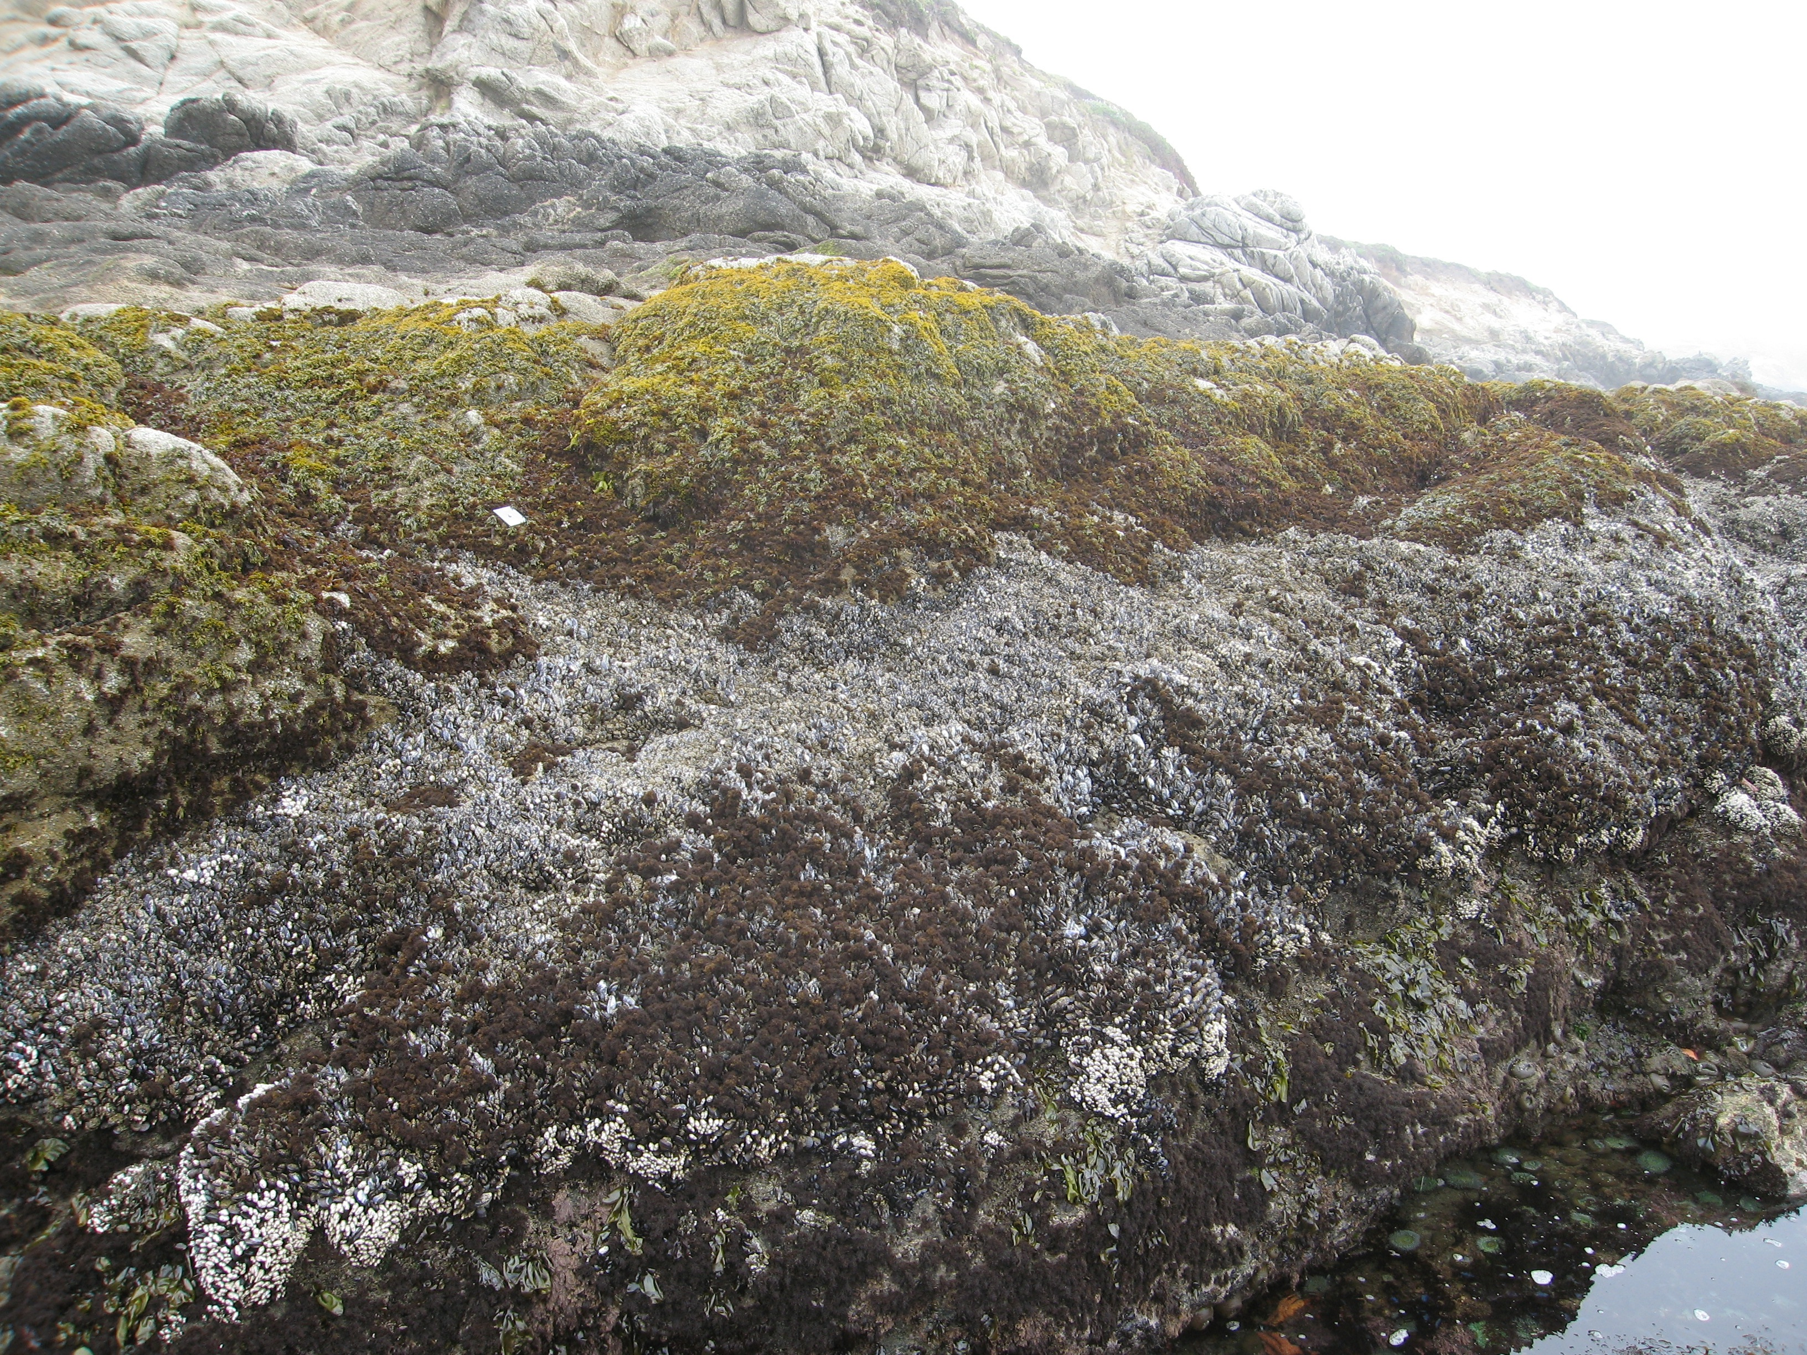

Slide 5
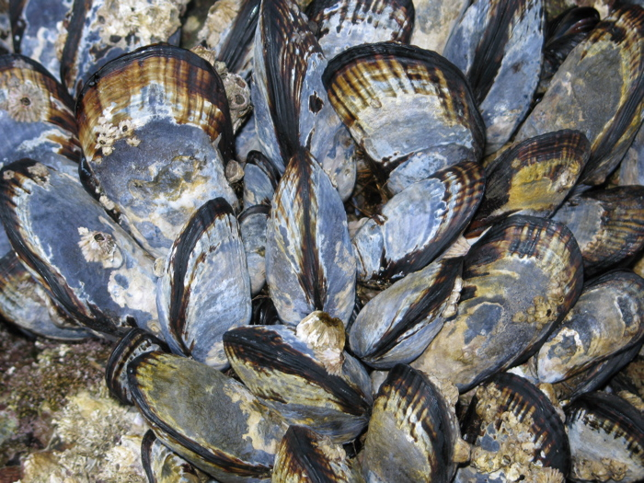

Slide 6
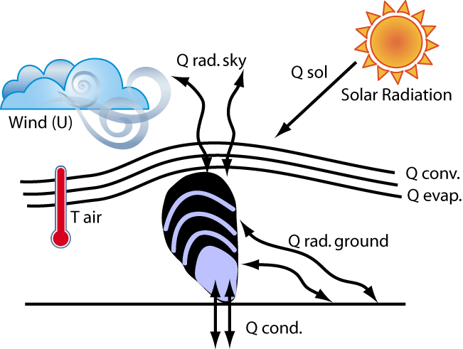
Helmuth 1998, 1999

Slide 7
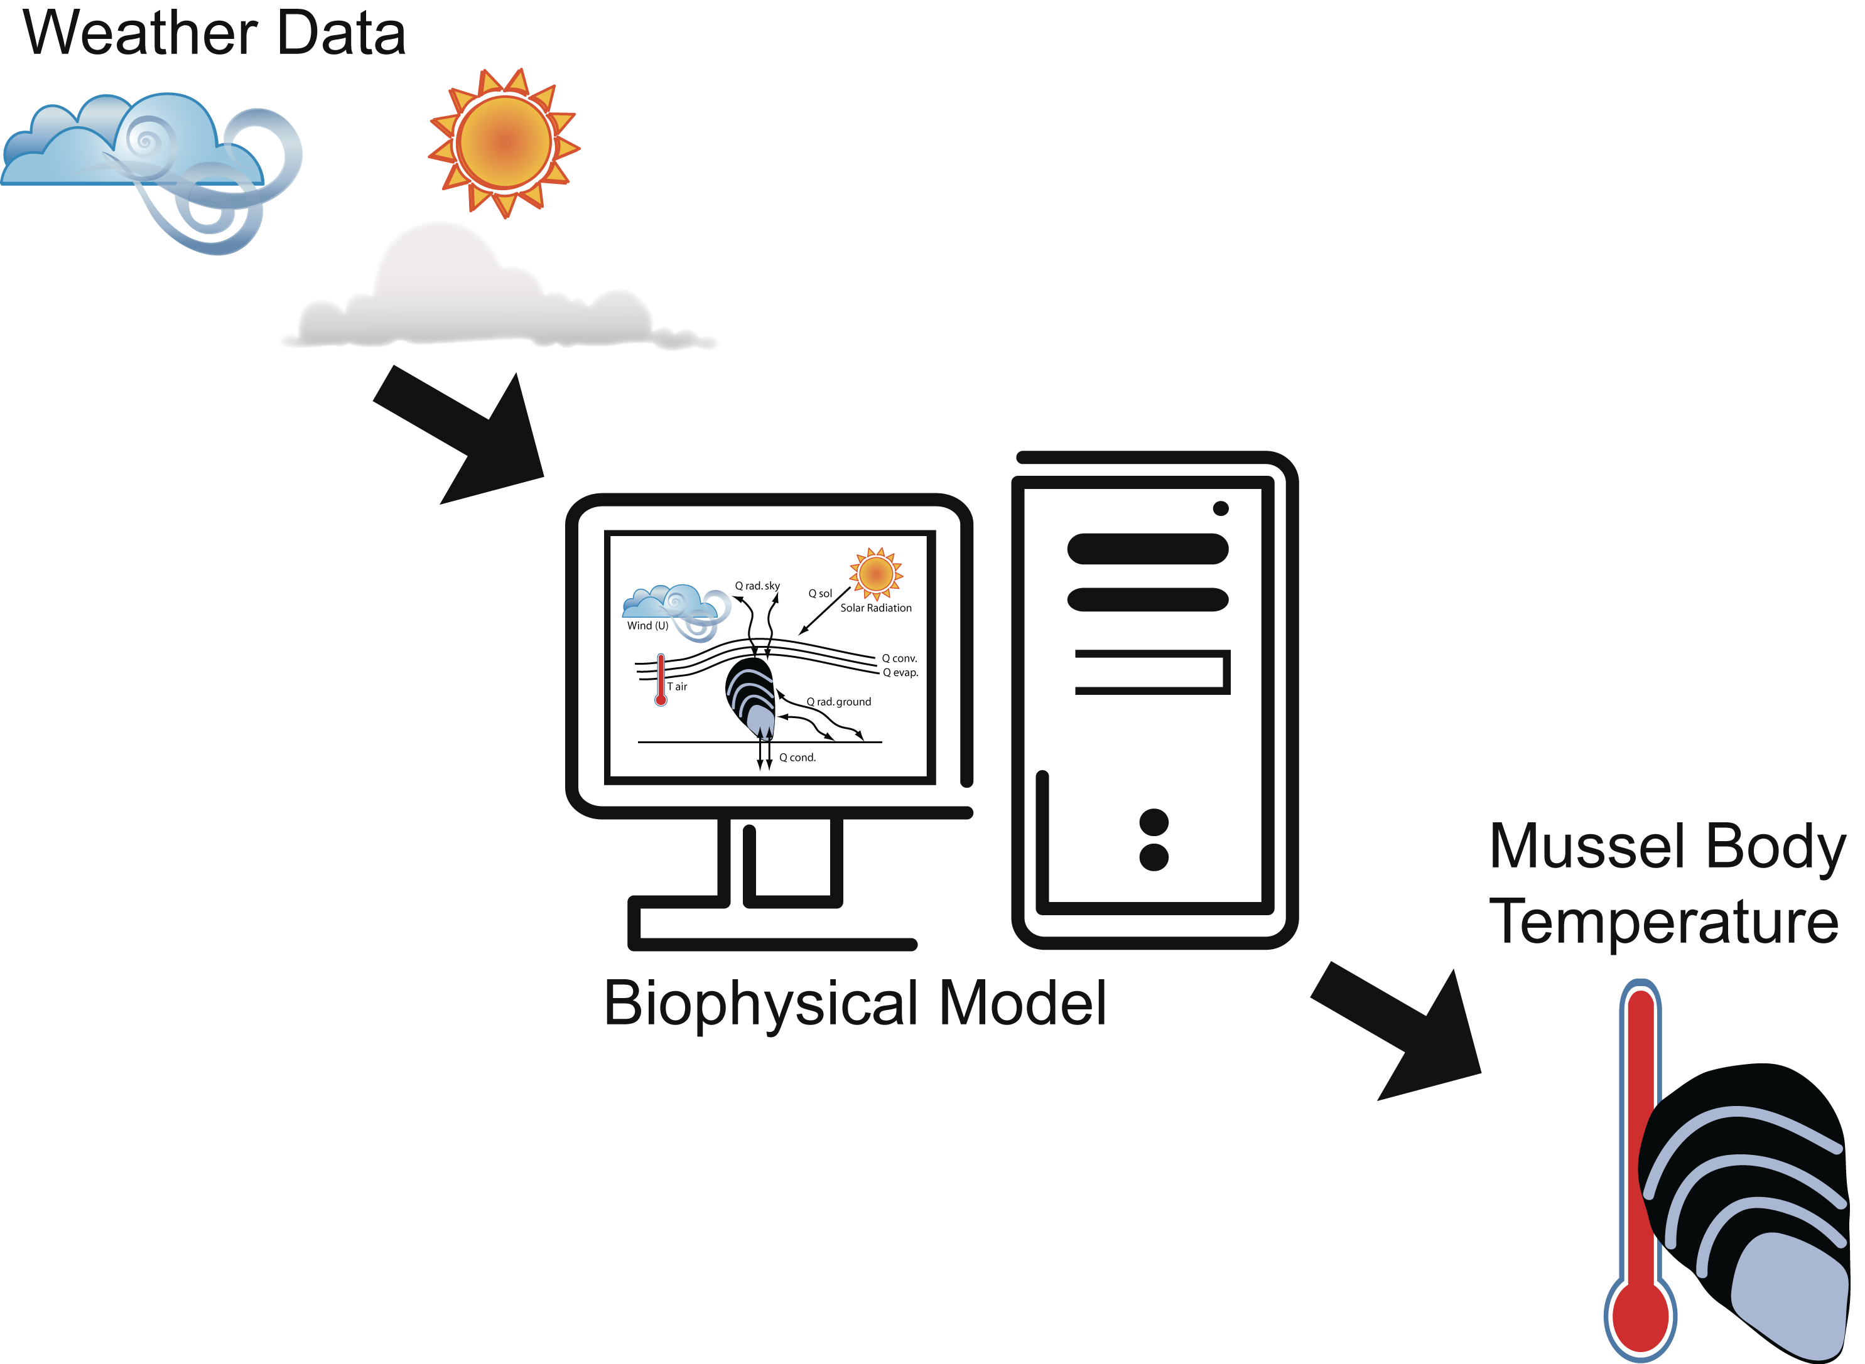
Helmuth 1998, 1999; Gilman et al. 2006; Wethey & Woodin 2008

Slide 8
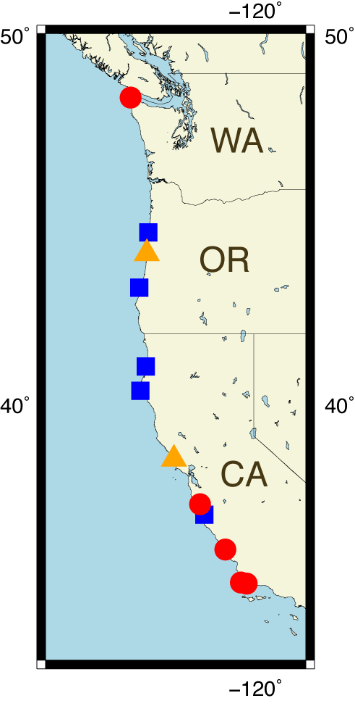
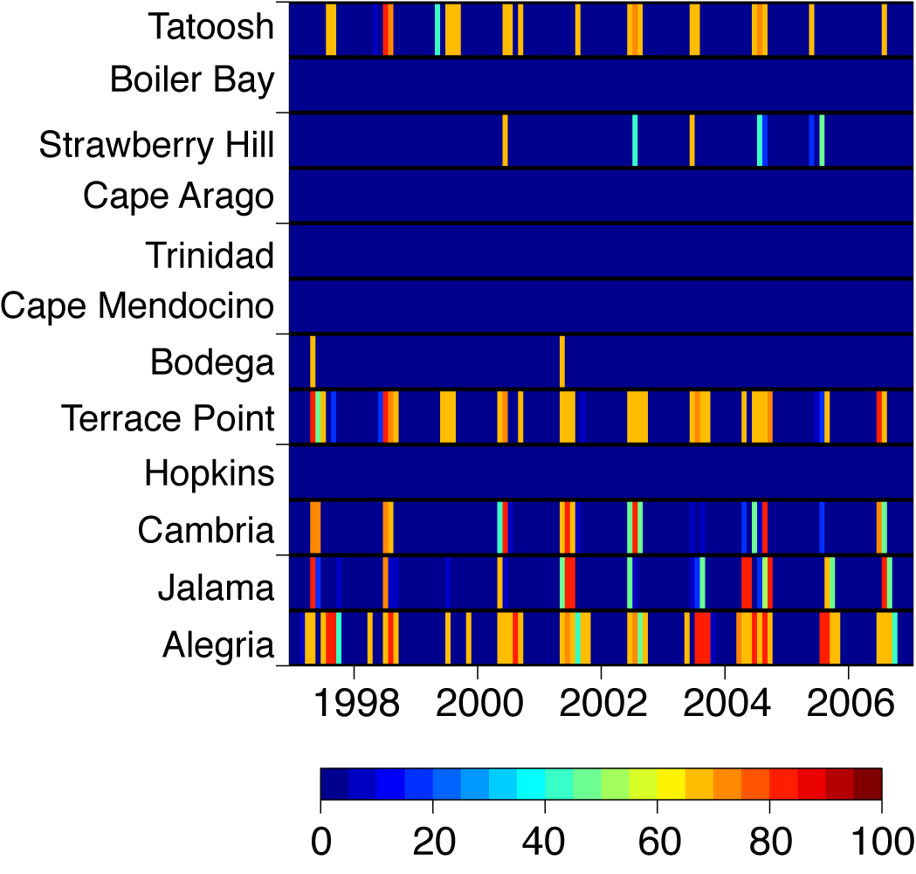
Ultimate Goal: Estimate Temperature Driven Mortality
Percent
Mortality

Slide 9
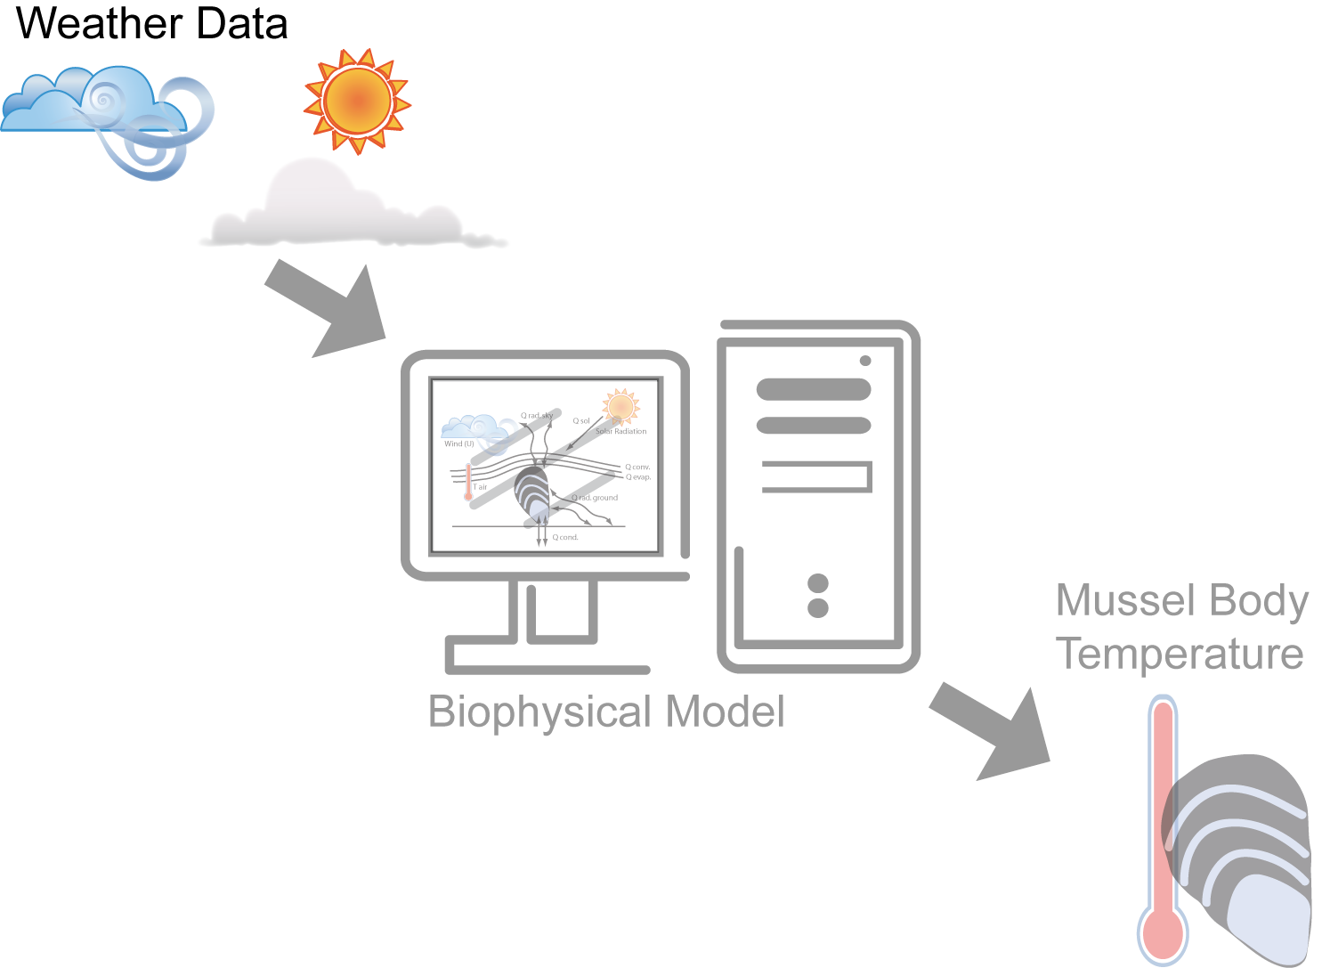
Helmuth 1998, 1999; Gilman et al. 2006; Wethey & Woodin 2008

Slide 10
What sources of weather data produce the best estimated mussel body temperatures?
Helmuth 1998, 1999; Gilman et al. 2006; Wethey & Woodin 2008

Slide 11
What sources of weather data produce the best estimated mussel body temperatures?
- quality
- large scales
Helmuth 1998, 1999; Gilman et al. 2006; Wethey & Woodin 2008

Slide 12
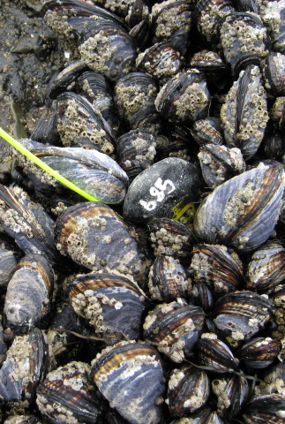
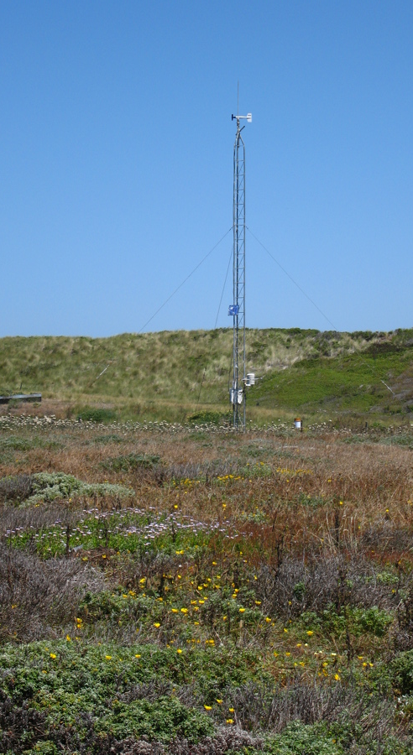
Reanalyzed Data
Satellite Data
Biomimetic Logger
Weather Station
www.NOAA.GOES.gov

Slide 13
Hopkins Marine Station, Monterey, California
2000-2006

Slide 14
Hopkins Marine Station, Monterey, California
2000-2006
Local
North America
Global

Slide 15
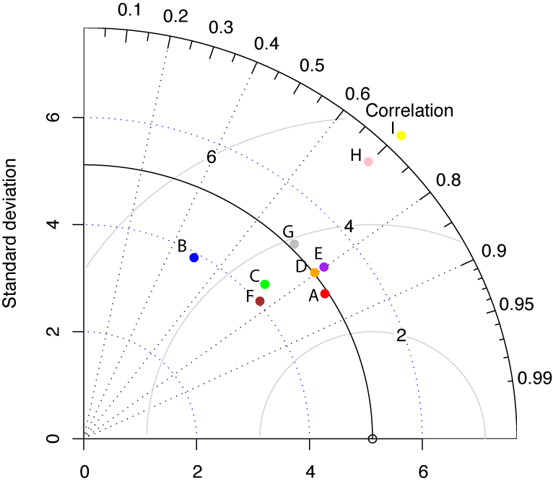
Daily Max Body Temperature
Biomimic

Slide 16
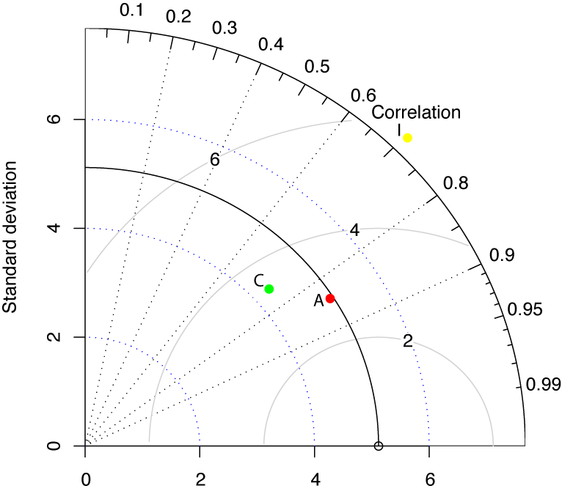
Daily Max Body Temperature
Biomimic

Slide 17
Forecast Verification
Based on Weather Forecasts
www.bom.gov.au/bmrc/wefor/staff/eee/verif/verif_web_page.html
WWRP/WCRP Joint Working Group on Verification
Why Verify?
Monitor Forecast Quality
Improve Forecast Quality
Compare Forecast Systems

Slide 18
Forecast Verification
Based on Weather Forecasts
www.bom.gov.au/bmrc/wefor/staff/eee/verif/verif_web_page.html
WWRP/WCRP Joint Working Group on Verification
What Makes a Forecast “Good”?
Consistency
Quality
Value

Slide 19
Daily Max Body Temperature Compared to Biomimetic Logger
A = Weather Station
At research site
10-minute intervals
C = North American Regional Reanalysis (NARR) with GOES Shortwave Downward Flux
32 km pixel (NARR) and 55 km pixel (GCIP)
3-hour intervals and 1-hour intervals
I = Global Reanalysis
277 km pixel
6-hour intervals

Slide 20
Daily Max Body Temperature Compared to Biomimetic Logger

Slide 21
Conclusions
Data Assemblage “C”
MAE = Acceptable (within 0.5°C of “A”)
Not modeling the stressful temperatures…

Slide 22
Future Directions
Add in SST products
Interpolate to a smaller grid size
Particularly important for global measurements
Conduct analyses at two additional sites
Long-Range Goal
GCM output into body temperature model to make predictions about future mortality events for mussels

Slide 23
Acknowledgements
David Wethey (Modeling)
Brian Helmuth (Biomimic Data)
Mark Denny (Weather Station Data)
NASA Earth Systems Science Fellowship
Elsie Tabor Travel Grant
NASA Grants NNG04GE43G, NNX07AF20G
NOAA Ecofore grant NA04NOS4780264

